Slide 1

TIME MANAGEMENT
Notes:
What you accomplish during a 24-hour period depends on your own motivation, your energy, your skills and abilities, and other resources.
Since there are always demands on your time, it may be helpful to think about what you will do with your time and to consider some strategies for more effective time management.
Time management is not a way to make you work harder and longer, but a means to help you work smarter to accomplish your work more easily and rapidly.

Slide 2

OBJECTIVES
Determine your priorities and your goals
To identify set of strategies and tools that will guide our decisions in making quality time management

Slide 3

DEFINITIONS
What is:
Time?
Management?
Time management?
Notes:
Time - the measured or measurable period during which an action, process, or condition exists or continues.
Management - the act or art of managing : the conducting or supervising of something (as a business).
Time management is straightforwardly defined as the management of time in order to make the most out of it.

Slide 4
Remember that time is money
Ben Franklin, 1748
Advice to a young tradesman

Slide 5
Hear me Now, Believe me Later
Being successful does not make you manage your time well
Managing your time well makes you successful

Slide 6

Time Management
There are still only 24 hours per day
It does not change
All we can manage is ourselves and what we do with the time we have!

Slide 7

Signs of time wasting
  Messy desk and cluttered (or no) files
  Cannot find things
  Missing appointments or Always rescheduling to the last minute
  Unprepared for meetings
  Volunteer to do things other people should do
  Tired/unable to concentrate
Notes:
The Problem is Severe
By some estimates, people waste about 2 hours per day.

Slide 8
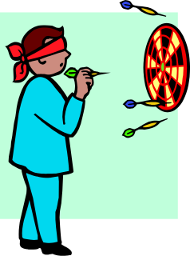

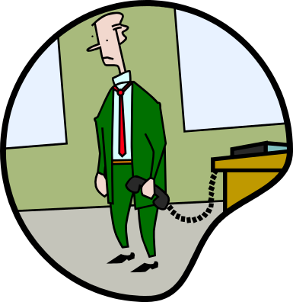
OBSTACLES TO EFFECTIVE TIME MANAGEMENT
Unclear objectives
Disorganisation
Inability to say “no”
Notes:
Note: You may wish to add personal experiences as examples of one or more of the obstacles to enhance the presentation.
There are a lot of things that make it difficult for us to manage our time effectively. Let’s consider some of the most common ones, and see if they apply to us:
Unclear objectives – It’s hard to hit a target with your eyes closed, and it’s just as hard to accomplish something when you aren’t exactly clear about what you want to achieve
Disorganization – It’s easy to see when your desk is too messy, but sometimes you have to step back and ask yourself if you are taking an organized approach in completing all of your tasks
Inability to say “no” – We all want to be as helpful as we can when others need us, but this can mean taking time away from other priorities to do something we may not have planned

Slide 9


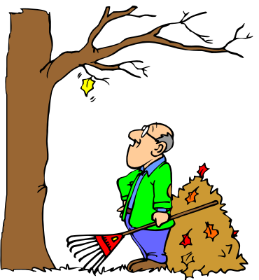
OBSTACLES TO EFFECTIVE TIME MANAGEMENT
Interruptions
More interruptions
Periods of inactivity
Notes:
Interruptions – Many times we are in the middle of accomplishing something really important and the telephone rings. These calls can not only take you away from your task, but sometimes they interrupt your train of thought and you can’t return to where you were without retracing your steps
More interruptions – We all like to visit with others, but conversations at inappropriate times can cost us time when we have to stop what we are doing and redirect ourselves from our plans
Periods of inactivity – As much as we think we are busy, there are times in our day when we are not really doing anything. Recognizing and making use of these times can have a positive effect on our efforts

Slide 10



OBSTACLES TO EFFECTIVE TIME MANAGEMENT
Trying to do too many things at once
Stress and fatigue
All work and no play
Notes:
Too many things at once – Many of our tasks are not routines. They require concentration to detail. When we are attempting to do too many different things at one time, each individual task suffers as a result
Stress and fatigue – Everyone experiences stress from time to time, and sometimes we actually operate a little better when there is some level of stress. Too much stress, on the other hand, causes our work to suffer and wears us down physically and mentally. Dealing with stress is an important part of time management
All work and no play – Most successful people know how to balance work and play. When work takes over your life, you not only give your body little time to re-energize, but you may end up sacrificing the really important things in life like family and friends

Slide 11

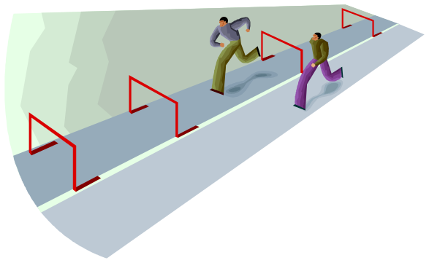
What can we do?
Recognise that obstacles exist
Identify them
Employ strategies to overcome
Notes:
The obstacles that we face are not insurmountable. Sometimes, the hardest thing to do is to identify that these obstacles exist and are affecting your ability to manage your time
When you have identified your obstacles you can begin to overcome them

Slide 12

TIME MANAGEMENT TOOLS
Goal setting
Prioritization
To do lists
Delegating
Leverage
Outsourcing

Slide 13
Relevance of Time management tools
Why am I doing this?
What is the goal?
Why will I succeed?
What happens if I chose not to do it?

Slide 14
“If you can dream it, you can do it”
Walt Disney
Disneyland was built in 366 days, from ground-breaking to first day open to the public.
Notes:
Planning
Failing to plan is planning to fail
Plan Each Day, Each Week, Each Month
You can always change your plan, but only once you have one!

Slide 15
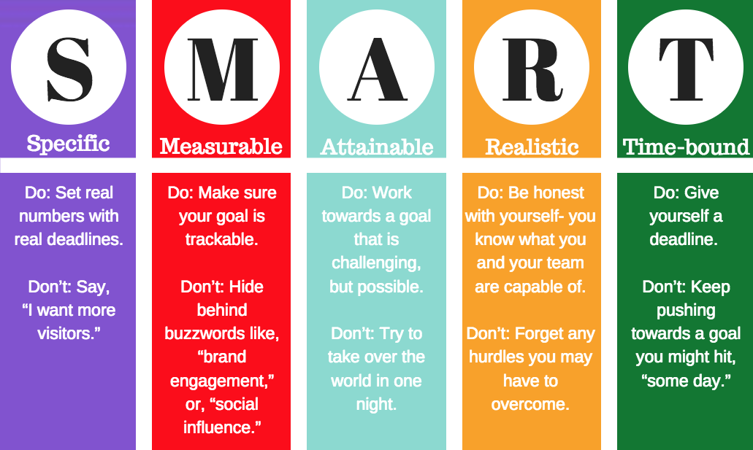
SET GOALS
S – Specific
M – Measurable
A – Attainable
R – Realistic
T – Time Based
Notes:
S - Specific
Distinct
Defines goals
No ambiguous language
M - Measurable
Feedback
Know when goal is complete
A – Assignable
Assign to either individuals or groups
R – Realistic
Will it work?
Is it challenging enough?
Is it attainable?
Is the time sufficient?
T – Time Based
Aggressive
Realistic

Slide 16

PRIORITIZE
Do
Delegate
Delay
Delete
Notes:
You will be faced with many tasks. It is safe to say that you will not be able to do everything, so it is wise to periodically make a list of the tasks that confront you and prioritize them. The following technique may be helpful in prioritizing:
Note: You may wish to provide examples of tasks that you have placed in each of the four categories that follow. Explain why you made the decision, and how it positively impacted your time management.
Do – Determine from the list the things you think are most important to accomplish, and are things you should do yourself.
Delegate – Remember that there many Lions within your district with skills, experience, and motivation to carry out a wide variety of tasks. Each participants should understand that real leaders do not try to accomplish everything themselves and recognizes that some things are better handled by others. Delegating not only frees up your time for other things, it ensures that resources are used wisely
Delay until another time – Some things can wait. The danger is delaying too many things until deadlines are near. The best policy here is to consider when things are due, how long it will take to accomplish them, and what your current workload will allow.
Delete – If you have set goals using the guidelines we mentioned earlier, you may recognize that some of them are not achievable or realistic, or that they are just not important. A good leader knows when to concentrate on the important and eliminate the rest.
Note: As time allows, you may wish to:
Ask selected participants to share tasks that they will prioritize into the four categories
Break participants into small groups and ask them to create a list of tasks that could be prioritized using the four categories

Slide 17

PRIORITIZE
Address the urgent
Accomplish what you can early
Attach deadlines to things you delay
Notes:
It is important when you have prioritized your tasks that you:
Address the urgent – Take care of things with short-term consequences as soon as possible.
Accomplish what you can early – Reports, registrations, requests that can be handled early should come next. Don’t put off until tomorrow what you can do today.
Attach deadlines to things you delay – When you have determined that something can definitely wait, don’t just toss it aside until later. Establish a deadline for the task in your schedule, and make a note to remind you to begin working on it.
Note: You may wish to emphasize the 80/20 rule here. (20% of your tasks can take 80% of your time.) This is a good point to keep in mind as you prioritize tasks.
The 80/20 Rule (Pareto Principle)
Critical few and the trivial many
Having the courage of your convictions
Good judgment comes from experience
Experiences comes from bad judgment

Slide 18
Prioritize your tasks
Where do the majority of your tasks fall on the chart?
 | Urgent | Not Urgent
Important | I Important and Urgent | II Important , but Not Urgent
Not Important | III Urgent, but Not Important | IV Not Urgent and Not Important
Notes:
Stephen Covey describes a high-level prioritization scheme in his book The Seven Habits of Highly Effective People. In this scheme, tasks are categorized by four quadrants:
QI – Important and Urgent
QII – Important, but Not Urgent
QIII – Not Important, but Urgent
QIV – Not Important and Not Urgent
Think of a party that you have planned. There are numerous tasks you must complete for the party to be a success. As we discuss each quadrant, think about where these tasks may fall.

Slide 19
Prioritization Quadrant
Quadrant I
Immediate Attention Required
 | Urgent | Not Urgent
Important | I Important and Urgent | II Important, but Not Urgent
Not Important | III Urgent, but Not Important | IV Not Urgent and Not Important
Notes:
Quadrant I – Important and Urgent. This quadrant include a crisis, pressing problems, deadline-driven projects, and meeting preparations. These should be completed today. If these are not done today, there will be serious repercussions.
Important and Urgent Party Task:
You are having a very large party at a local venue. The day before your party, the building catches fire and burns down. You now need to immediately locate a new venue for your event. This task is important because you need a place to have the party, as well as urgent, due to the party occurring the next day. This requires your immediate attention, or the party will not be a success.

Slide 20
Prioritization Quadrant
Quadrant II
Requires attention, but not yet critical
 | Urgent | Not Urgent
Important | I Important and Urgent | II Important, but Not Urgent
Not Important | III Urgent, but Not Important | IV Not Urgent and Not Important
Notes:
Quadrant II – Important, but Not Urgent. (Preparations, Presentations, Planning, Relationship Building, True Recreation, Empowerment) – These should be done soon. It would be nice to do these today; but, they can be put off for a later time. If these are not completed, nothing significant will happen.
Dr. Covey notes that highly effective people make time for the QII activities, and that doing so can reduce the time spent in other quadrants.
Important, but Not Urgent Party Scenario:
It is two months before your big party. You need to order invitations, and have made an appointment with the local stationary store. This is an important task, but at this time, it is not urgent.

Slide 21
Prioritization Quadrant
Quadrant III
“Nice to do”
 | Urgent | Not Urgent
Important | I Important and Urgent | II Important, but Not Urgent
Not Important | III Urgent, but Not Important | IV Not Urgent and Not Important
Notes:
Quadrant III – Urgent, but Not Important. (Interruptions, some phone calls, some mail, some reports, some meetings, many proximate pressing matters, many popular activities) – There is not a set time frame. These are “nice to do” items. If these items are not done, nothing significant will happen.
Urgent, but Not Important Party Scenario:
Three days before your party, you decide that it would be really nice to have 300 handmade party favors ready for your guests. Because it is so close to your party date, this is an urgent task. However, if you do not complete this task, nothing significant will happen. You will still have a nice party, and your guests will not know the difference.

Slide 22
Prioritization Quadrant
Quadrant IV
These activities are time eaters
 | Urgent | Not Urgent
Important | I Important and Urgent | II Important, but Not Urgent
Not Important | III Urgent, but Not Important | IV Not Urgent and Not Important
Notes:
Quadrant IV – Not Urgent and Not Important. (Trivia, busywork, junk mail, some phone calls, time thieves, “escape” activities) – These items are your time eaters.
Effective people stay out of Quadrants III and IV because, urgent or not, they are not important. They also shrink Quadrant I down to size by spending more time in Quadrant II, which is the heart of effective personal management. Our effectiveness takes a quantum leap when we start doing the things in Quadrant II on a regular basis.
Not Urgent and Not Important Party Scenario:
You have two weeks until your party, and decide that you would like to add another food item to your menu. You already have enough food ordered, and this item is not needed. Since you have plenty of time, this is not an urgent matter. Also, if you do not add this item to your menu, there are no significant consequences, making the task “not important.”

Slide 23
Stephen Covey’s Time Management Matrix
Urgent
Not Urgent
I
II
. Crisis
. Pressing problems
. Deadline-driven projects, meetings, preparations
. Preparation
. Prevention
. Values clarification
. Planning
. Relationship building
. True re-creation
. Empowerment
Important
III
IV
. Interruptions, some
phone calls
. Some mails, some reports
. Some meetings
. Many close
pressing matters
. Many popular activities
. Trivia, busywork
. Some phone calls
. Time wasters
. “Escape” activities
. Irrelevant mails
. Excessive TV
Not Important

Slide 24
TO Do Lists
Break things down into small steps
Do the hardest thing first
(www.thesimpledollar.com/do-the-hard-things-first)
Notes:
Do the hardest thing first (this way you tackle it with the most energy and the freshest mind)

Slide 25

DELEGATING
To delegate is to entrust (a task or responsibility) to another person, typically one who is less senior than oneself
This helps in keeping followers engaged and motivated
Notes:
Keeps one focused on more challenging activities while those that need little or no supervision could be delegated
It helps to bring out qualities in others that can be developed
Increases team building: learn to train, motivate and empower others

Slide 26
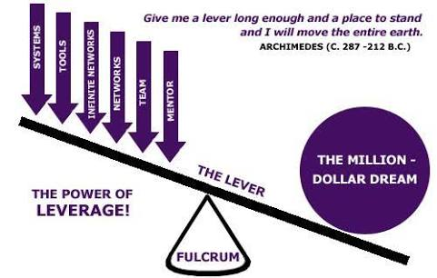
LEVERAGE (Your advantage)
Leverage means using your added advantage to get the job done
Achieving more with the same effort
Notes:
We have so much resources, especially with the age of technology ; this helps to get the job done faster

Slide 27

OUTSOURCING
This enables everyone to concentrate on their core competencies
By assigning non core tasks to people with expertise to increase efficiency
Notes:
To outsource means to contract (work) out, usually to a third party.

Slide 28
THINGS TO CONSIDER WHEN OUTSOURCING
Core competence
Timing
Urgency
Cost

Slide 29


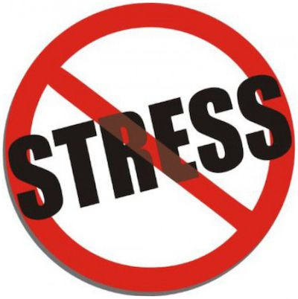
MERITS OF TIME MANAGEMENT
Increase in productivity and efficiency
Increased opportunity for progress and advancement
Eliminates procrastination
Increases quality client service and satisfaction
Reduces stress
Notes:
If you can manage your time more effectively, you will be rewarded in a variety of ways:
You will be more efficient in serving your clients
You will achieve greater success
On a personal level, you will certainly feel healthier, more energetic, and in a generally better mood

Slide 30



DEMERITS OF TIME MANAGEMENT
Reduces quality client satisfaction, which in turn could reduce number of referrals and clients
Low productivity
Increased “missed deadlines”
Increased stress; affecting ones’ health
Poor professional recommendations

Slide 31


Learn when to say “NO”
You can not do everything
Do not undertake things you can not complete
Notes:
The strategies we have mentioned so far have all concerned common business practices. Now I would like to address some more “personal” strategies that you can apply to your life. These also have a great impact on how effectively you manage your time.
The first of these strategies is being able to say “NO” when it is appropriate.
When you learn to say “NO” you are not closing the door on your responsibilities, but rather you are making sure that you can meet your commitments and accomplish the maximum possible in the time available to you.
To be able to say “NO” you will have to accept these three principles:
I realize that I can’t do everything
I won’t agree to undertake a task or project that I know I will not be able to complete in the timeframe required
I will not make commitments that are not consistent with the goals and objectives I have set for myself
If you keep these principles in mind, you will find it easier to justify (and explain) why some requests must be turned down. You will also find that you are better able to accomplish the things that you have prioritized as “must do.”

Slide 32

Use your waiting time
On public transportation
At the doctor’s office
Waiting to board a plane
On hold
When you are early at work
Notes:
Another personal time management skill is to make good use of your “waiting time.”
Have you ever thought about how much time you spend doing nothing during an average day? Usually this is not a situation where you planned to do nothing…it just happened. Think about all of the things you could accomplish if you could make use of this time. For instance:
Time you spend commuting on a train or bus
Time you wait at the doctor or dentist office for your appointment
Time you spend on a plane, waiting for your plane, or the time you spend waiting for your baggage
Time you spend “on hold” on the telephone
Time you spend when you arrive at work or at a meeting earlier than you had anticipated
Note: You may include other examples or ask participants for their own ideas.
There are two ways to look at these periods of time. You can either consider them as “wastes of time” or as “gifts of time.” If you choose to think of them as gifts of time, you can use them as opportunities to accomplish routine tasks that are necessary, but don’t require large periods of time.
Most successful people have already found that there are a number of things that they can accomplish while they wait.

Slide 33



Use your waiting time
Correspondence
Letters or memos
Read books OR Listen to audio messages
Notes:
The trick to making use of your waiting time is to always make sure you have something with you that you can accomplish in the event that you are kept waiting. For instance:
Reading correspondence – Take your mail with you and read it while you are waiting or traveling. Some PDAs have e-mail capability, so you can read your e-mail on a train or plane or at the doctor’s office
Writing letters or memos – While you wait, you can take out a notepad or use a PDA to write letters or memos. This could also be a good time to update your planner
Reading or listening to tapes – Carry a book or magazine or a tape with you. You can also download books and articles to your PDA. There is often no time in your schedule to keep current on books or articles related to your business or to self-improvement. Instead of being impatient when you are delayed, this could be a perfect time to advance your own knowledge and skills.
Note: This would be a good time to describe some ways you personally fill the “waiting times” in your schedule, and how you feel it has helped you manage your time overall.

Slide 34

Concentrate on the task at hand
Focus on your goal
Tune out interruptions
Notes:
You will be juggling many tasks. There is no way around this fact. But one important strategy to keep in mind is to concentrate completely on the current task. Concentration can be difficult when you have a lot on your mind. Your time will be better spent if you are able to:
Focus on your goal – You may have many commitments and many concerns, but you will accomplish more when you keep focused on the one task you are performing at the moment
Tune out interruptions – You will find your concentration is at its highest level when you can set aside times during the day when you will not answer the phone or schedule visitors. You can’t isolate yourself all of the time, but by avoiding interruptions for specific periods of time, you may find you can accomplish tasks successfully in far less time than you anticipated. When you must respond to phone calls, be assertive in minimizing interruptions by asking if you can call back at another time or meet another day.

Slide 35

NEVER PROCRASTINATE
The work will not disappear!
“Procrastination is the
thief of time”
Edward Young
Night Thoughts, 1742

Slide 36

Consider your personal prime time
Morning?
Evening?
Late night?
Notes:
Are you one of those people who gets up before the sun rises and starts working? Is the early evening, after the evening meal, your time to work? Or are you someone who prefers to wait until the quiet of the late night hours to do the really hard tasks?
Everyone is different. Most research shows that tasks that take the most mental concentration are most effectively accomplished early in the day, but even these studies acknowledge that this is not always true, and that everyone has a “personal prime time.”
When you plan your tasks, think about your own “prime time.” If you do your best work early, plan to do the routine tasks later in the day and concentrate on the more challenging tasks when you are at your best. If you don’t really get going until later, handle the routines in the morning and save the more difficult tasks for later.

Slide 37

SUMMARY
  Set goals
  Prioritize
  Learn when to say “NO”
  Use your waiting time
  Concentrate on the task at hand
  Consider your personal prime time
  Celebrate success
Notes:
Note: Review the strategies for time management that you have presented.

Slide 38
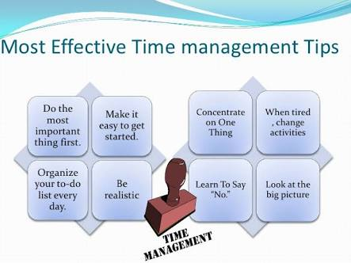
WHAT DRIVES EFFECTIVE TIME MANAGEMENT?

Slide 39

MULTI-TASKING
Many of us think that multitasking is the best way to get through a demanding day, however this is a myth!
Reduces your ability to focus
Lowers the quality of work
It can actually cost you more time
Notes:
It is important to stop multitasking as soon as you realise you are doing so.
Schedule your day into blocks of time; minimize and manage interruptions, and work on improving your concentration.

Slide 40
TIME MANAGEMENT PLEDGE
TODAY I WILL INVEST MY MOST VALUABLE RESOURCE; MY TIME;
INTO MY MOST VALUABLE POSSESION: MY LIFE.

Slide 41
CONCLUSION
Effective time management involves managing people, resources and technology available to us
“The world is changing very fast. Big no longer beats the small. It’s now the fast beating the slow’’ Michael Jackson(Challenge of Change)

Slide 42


